Slide 1
MapReduce Programming
Randal E. Bryant
Carnegie Mellon University
Topics
Large-scale computing
Traditional high-performance computing (HPC)
Cluster computing
MapReduce
Definition
Examples
Implementation
Alternatives to MapReduce
Properties

Slide 2
Typical High Performance Computing Machine
Compute Nodes
High end processor(s)
Lots of RAM
Network
Specialized
Very high performance
Storage Server
RAID-based disk array
Compute Nodes
CPU
CPU
CPU
• • •
Mem
Mem
Mem
Network
Storage Server
• • •

Slide 3
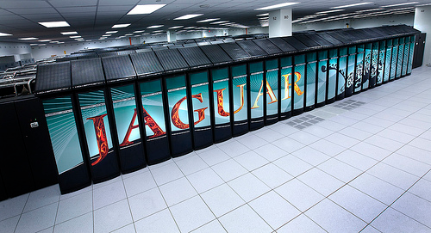
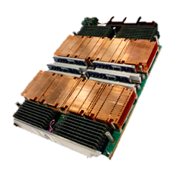
HPC Machine Example
Jaguar Supercomputer
6th fastest in world
Compute Nodes
18,688 node
Node
2X 2.6Ghz 6-core AMD Opteron
16GB memory
Combined total
2.3 petaflop / 300 TB memory
5.1 MW total power consumption
Network
3D torus
Each node connected to 6 neighbors via 6.0 GB/s links
Storage Server
10PB RAID-based disk array

Slide 4
HPC Programming Model
Application
Programs
Software
Packages
Machine-Dependent
Programming Model
Hardware
Programs described at very low level
Specify detailed control of processing & communications
Rely on small number of software packages
Written by specialists
Limits classes of problems & solution methods

Slide 5
Bulk Synchronous Programming
Solving Problem Over Grid
E.g., finite-element computation
Partition into Regions
p regions for p processors
Map Region per Processor
Local computation sequential
Periodically communicate boundary values with neighbors

Slide 6
Typical HPC Operation
Characteristics
Long-lived processes
Make use of spatial locality
Hold all program data in memory (no disk access)
High bandwidth communication
Strengths
High utilization of resources
Effective for many scientific applications
Weaknesses
Requires careful tuning of application to resources
Intolerant of any variability
Message Passing
P₁
P₂
P₃
P₄
P₅

Slide 7
HPC Fault Tolerance
P₁
P₂
P₃
P₄
P₅
Checkpoint
Checkpoint
Periodically store state of all processes
Significant I/O traffic
Restore
When failure occurs
Reset state to that of last checkpoint
All intervening computation wasted
Performance Scaling
Very sensitive to number of failing components
Wasted
Computation
Restore
Checkpoint

Slide 8
Examples of Big Data Sources
Wal-Mart
267 million items/day, sold at 6,000 stores
HP built them 4 PB data warehouse
Mine data to manage supply chain, understand market trends, formulate pricing strategies
LSST
Chilean telescope will scan entire sky every 3 days
A 3.2 gigapixel digital camera
Generate 30 TB/day of image data

Slide 9
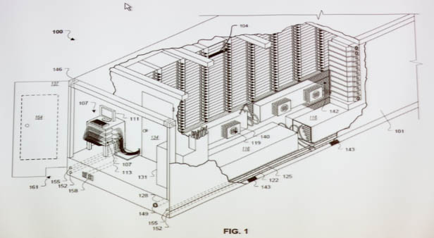
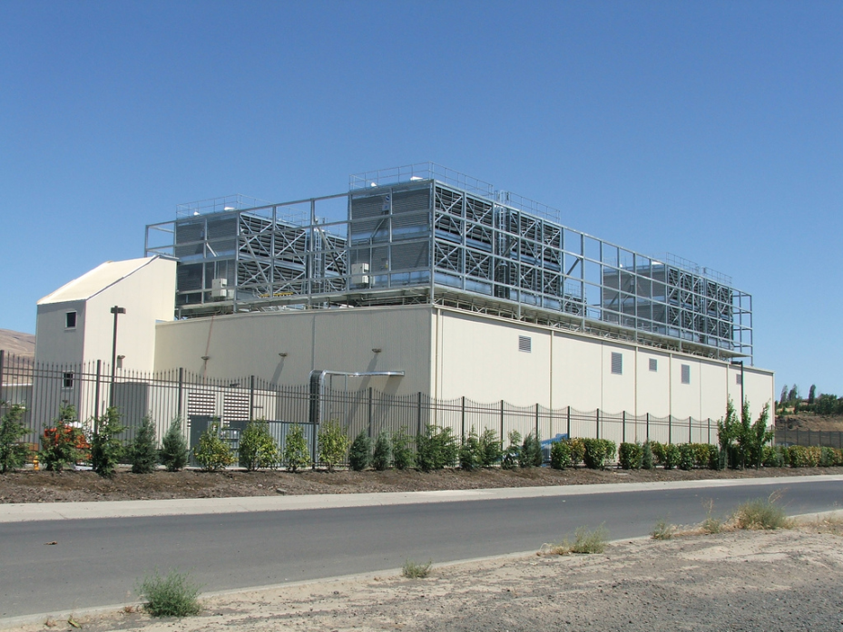
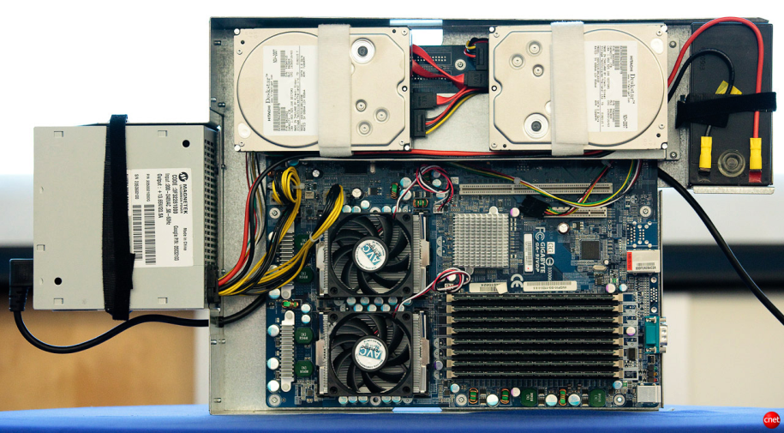
Google Data Centers
Dalles, Oregon
Hydroelectric power @ 2¢ / KW Hr
50 Megawatts
Enough to power 60,000 homes
Engineered for maximum modularity & power efficiency
Container: 1160 servers, 250KW
Server: 2 disks, 2 processors
Notes:
One of the biggest users of cluster computing is Google. They have set up dozens of data centers around the world, containing more computer power than just about anyone else.
Here’s a picture of their data center in Dalles, Oregon. It cost them $600M and requires around 50 megawatts of power. (For reference, that much power would supply the residential electricity needs of 6,000 households in the U.S.). They located the data center near the Columbia River to take advantage of low-cost electricity.
Imagine what our intelligence sources could do if they had facilities on this scale to store and process satellite imagery, voice signals, and feeds from media outlets.

Slide 10
Typical Cluster Machine
Compute + Storage Nodes
Medium-performance processors
Modest memory
1-2 disks
Network
Conventional Ethernet switches
10 Gb/s within rack
100 Gb/s across racks
Compute + Storage Nodes
CPU
CPU
CPU
• • •
Mem
Mem
Mem
Network

Slide 11
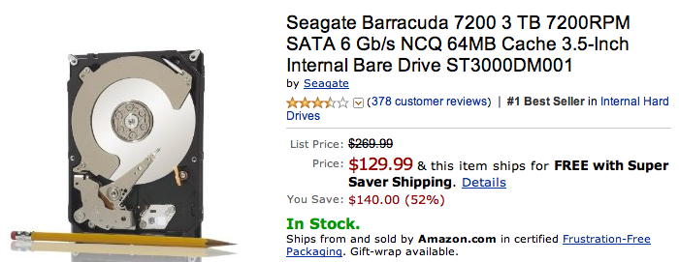
Machines with Disks
Lots of storage for cheap
Seagate Barracuda
3 TB @ $130
(4.3¢ / GB)
Compare 2007:
0.75 TB @ $266
35¢ / GB
Drawbacks
Long and highly variable delays
Not very reliable
Not included in HPC Nodes

Slide 12
Oceans of Data, Skinny Pipes
1 Terabyte
Easy to store
Hard to move
Disks | MB / s | Time
Seagate Barracuda | 115 | 2.3 hours
Seagate Cheetah | 125 | 2.2 hours
Networks | MB / s | Time
Home Internet | < 0.625 | > 18.5 days
Gigabit Ethernet | < 125 | > 2.2 hours
PSC Teragrid Connection | < 3,750 | > 4.4 minutes

Slide 13
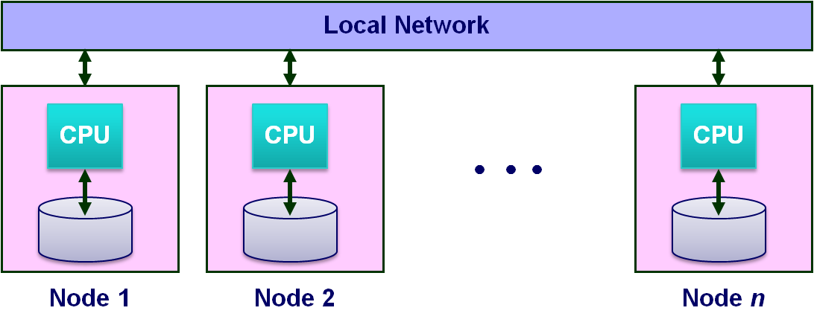
Data-Intensive System Challenge
For Computation That Accesses 1 TB in 5 minutes
Data distributed over 100+ disks
Assuming uniform data partitioning
Compute using 100+ processors
Connected by gigabit Ethernet (or equivalent)
System Requirements
Lots of disks
Lots of processors
Located in close proximity
Within reach of fast, local-area network

Slide 14
Ideal Cluster Programming Model
Application
Programs
Machine-Independent
Programming Model
Runtime
System
Hardware
Application programs written in terms of high-level operations on data
Runtime system controls scheduling, load balancing, …

Slide 15
Map/Reduce Programming Model
k₁
k₁
k_{r}
• • •
Reduce
Key-Value
Pairs
M
M
M
• • •
M
Map
x₁
x₂
x₃
x_{n}
Map computation across many objects
E.g., 10¹⁰ Internet web pages
Aggregate results in many different ways
System deals with issues of resource allocation & reliability
Dean & Ghemawat: “MapReduce: Simplified Data Processing on Large Clusters”, OSDI 2004

Slide 16
MapReduce Example
Come,
Dick
Come and see.
Come, come.
Come and see.
Come and see Spot.
Create an word index of set of documents

Slide 17
MapReduce Example
1
3
6
3
1
dick
∑
and
∑
come
∑
see
∑
spot
∑
Sum
⟨see, 1⟩
⟨dick, 1⟩
⟨come, 1⟩
Word-Count
Pairs
⟨come, 1⟩
⟨come, 1⟩
⟨spot, 1⟩
⟨and, 1⟩
⟨see, 1⟩
⟨come, 1⟩
⟨come, 2⟩
⟨and, 1⟩
⟨and, 1⟩
M
M
M
M
M
Extract
Come,
Dick
Come and see.
Come, come.
Come and see.
Come and see Spot.
Map: generate ⟨word, count⟩ pairs for all words in document
Reduce: sum word counts across documents

Slide 18
Hadoop Project
File system with files distributed across nodes
Store multiple (typically 3 copies of each file)
If one node fails, data still available
Logically, any node has access to any file
May need to fetch across network
Map / Reduce programming environment
Software manages execution of tasks on nodes
Local Network
CPU
CPU
CPU
• • •
Node 1
Node 2
Node n

Slide 19
Hadoop MapReduce API
Requirements
Programmer must supply Mapper & Reducer classes
Mapper
Steps through file one line at a time
Code generates sequence of <key, value> pairs
Call output.collect(key, value)
Default types for keys & values are strings
Lots of low-level machinery to convert to & from other data types
But can use anything “writable”
Reducer
Given key + iterator that generates sequence of values
Generate one or more <key, value> pairs
Call output.collect(key, value)

Slide 20
Hadoop Word Count Mapper
public class WordCountMapper extends MapReduceBase
implements Mapper {
private final static Text word = new Text();
private final static IntWritable count = new IntWritable(1);
public void map(WritableComparable key, Writable values,
OutputCollector output, Reporter reporter)
throws IOException {
/* Get line from file */
String line = values.toString();
/* Split into tokens */
StringTokenizer itr = new StringTokenizer(line.toLowerCase(),
" \t.!?:()[],'&-;|0123456789");
while(itr.hasMoreTokens()) {
word.set(itr.nextToken());
/* Emit <token,1> as key + value
output.collect(word, count);
}
}
}

Slide 21
Hadoop Word Count Reducer
public class WordCountReducer extends MapReduceBase
implements Reducer {
public void reduce(WritableComparable key, Iterator values,
OutputCollector output, Reporter reporter)
throws IOException {
int cnt = 0;
while(values.hasNext()) {
IntWritable ival = (IntWritable) values.next();
cnt += ival.get();
}
output.collect(key, new IntWritable(cnt));
}
}

Slide 22
MapReduce Implementation
Built on Top of Parallel File System
Google: GFS, Hadoop: HDFS
Provides global naming
Reliability via replication (typically 3 copies)
Breaks work into tasks
Master schedules tasks on workers dynamically
Typically #tasks >> #processors
Net Effect
Input: Set of files in reliable file system
Output: Set of files in reliable file system

Slide 23
MapReduce Execution
R Output Files
Reducer
Reducer
Reducer
• • •
R Reducers
Shuffle
Task Manager
Mapper
Mapper
Mapper
• • •
M Mappers
Input Files (Partitioned into Blocks)

Slide 24
Mapping
h
K
Hash Function h
Maps each key K to integer i such that 0 ≤ i < R
Mapper Operation
Reads input file blocks
Generates pairs ⟨K, V⟩
Writes to local file h(K)
Local
Files

Slide 25
Mapping
Dynamically map input file blocks onto mappers
Each generates key/value pairs from its blocks
Each writes R files on local file system
R local files
per mapper
•••
•••
•••
Mapper
Mapper
Mapper
• • •
M Mappers
Task Manager
Input Files (Partitioned into Blocks)

Slide 26
Shuffling
Each Reducer:
Handles 1/R of the possible key values
Fetches its file from each of M mappers
Sorts all of its entries to group values by keys
Reducer
Reducer
Reducer
• • •
R Reducers
M X R
local files
•••
•••
•••

Slide 27
Reducing
Each Reducer:
Executes reducer function for each key
Writes output values to parallel file system
R Output Files
Reducer
Reducer
Reducer
• • •
R Reducers

Slide 28
MapReduce Effect
R Output Files
MapReduce
Input Files (Partitioned into Blocks)
MapReduce Step
Reads set of files from file system
Generates new set of files
Can iterate to do more complex processing

Slide 29
Map/Reduce Operation Summary
Characteristics
Computation broken into many, short-lived tasks
Mapping, reducing
Use disk storage to hold intermediate results
Strengths
Great flexibility in placement, scheduling, and load balancing
Can access large data sets
Weaknesses
Higher overhead
Lower raw performance
Map/Reduce
Map
Reduce
Map
Reduce
Map
Reduce
Map
Reduce

Slide 30
Map/Reduce Fault Tolerance
Data Integrity
Store multiple copies of each file
Including intermediate results of each Map / Reduce
Continuous checkpointing
Recovering from Failure
Simply recompute lost result
Localized effect
Dynamic scheduler keeps all processors busy
Map/Reduce
Map
Reduce
Map
Reduce
Map
Reduce
Map
Reduce

Slide 31
Interesting Features
Fault Tolerance
Assume reliable file system
Detect failed worker
Heartbeat mechanism
Reschedule failed task
Stragglers
Tasks that take long time to execute
Might be bug, flaky hardware, or poor partitioning
When done with most tasks, reschedule any remaining executing tasks
Keep track of redundant executions
Significantly reduces overall run time

Slide 32
Cluster Scalability Advantages
Distributed system design principles lead to scalable design
Dynamically scheduled tasks with state held in replicated files
Provisioning Advantages
Can use consumer-grade components
maximizes cost-peformance
Can have heterogenous nodes
More efficient technology refresh
Operational Advantages
Minimal staffing
No downtime

Slide 33
Exploring Parallel Computation Models
Map/Reduce
MPI
SETI@home
Threads
PRAM
Low Communication
Coarse-Grained
High Communication
Fine-Grained
Map/Reduce Provides Coarse-Grained Parallelism
Computation done by independent processes
File-based communication
Observations
Relatively “natural” programming model
Research issue to explore full potential and limits

Slide 34
Beyond Map/Reduce
Typical Map/Reduce Applications
Sequence of steps, each requiring map & reduce
Series of data transformations
Iterating until reach convergence
Strengths of Map/Reduce
User writes simple functions, system manages complexities of mapping, synchronization, fault tolerance
Very general
Good for large-scale data analysis
Limitations
No locality of data or activity
Each map/reduce step must complete before next begins

Slide 35
Generalizing Map/Reduce
Microsoft Dryad Project
Computational Model
Acyclic graph of operators
But expressed as textual program
Each takes collection of objects and produces objects
Purely functional model
Implementation Concepts
Objects stored in files or memory
Any object may be lost; any operator may fail
Replicate & recompute for fault tolerance
Dynamic scheduling
# Operators >> # Processors
Op_{k}
Op_{k}
Op_{k}
• • •
Op_{k}
• • •
Op₂
Op₂
Op₂
• • •
Op₂
Op₁
Op₁
Op₁
• • •
Op₁
x₁
x₂
x₃
x_{n}

Slide 36
CMU GraphLab
Carlos Guestrin, et al.
Graph algorithms used in machine learning
View Computation as Localized Updates on Graph
New value depends on own value + those of neighbors
Update repeatedly until converge

Slide 37
Machine Learning Example
PageRank Computation
Larry Page & Sergey Brinn, 1998
Rank “Importance” of Web Pages
1.20
0.79
1.51
0.42
1.16
0.78
1.14

Slide 38
PageRank Computation
Initially
Assign weight 1.0 to each page
Iteratively
Select arbitrary node and update its value
Convergence
Results unique, regardless of selection ordering
R₂
R₃
R₁
R₅
R₁ ← 0.1 + 0.9 * (½ R₂ + ¼ R₃ + ⅓ R₅)

Slide 39
PageRank with Map/Reduce
R₁ ← 0.1 + 0.9 * (½ R₂ + ¼ R₃ + ⅓ R₅)
Each Iteration: Update all nodes
Map: Generate values to pass along each edge
Key value 1: (1, ½ R₂) (1, ¼ R₃) (1, ⅓ R₅)
Similar for all other keys
Reduce: Combine edge values to get new rank
R₁ ← 0.1 + 0.9 * (½ R₂ + ¼ R₃ + ⅓ R₅)
Similar for all other nodes
Performance
Very slow!
Altavista Webgraph 2002
1.4B vertices, 6.7B edges
Hadoop
800 cores
9000s

Slide 40
PageRank with GraphLab
Operation
Graph partitioned across multiple processors
Each doing updates to its portion of graph
Exploits locality
Greater asynchrony
Only iterate over portions of graph where values are changing
Performance
Altavista Webgraph 2002
1.4B vertices, 6.7B edges
Hadoop
800 cores
9000s
Prototype GraphLab2
512 cores
431s

Slide 41
Conclusions
Distributed Systems Concepts Lead to Scalable Machines
Loosely coupled execution model
Lowers cost of procurement & operation
Map/Reduce Gaining Widespread Use
Hadoop makes it widely available
Great for some applications, good enough for many others
Lots of Work to be Done
Richer set of programming models and implementations
Expanding range of applicability
Problems that are data and compute intensive
The future of supercomputing?

