Slide 1


Symposium:
A Computer Based Reading Tutor for Young English Language Learners: Recent Research on Proficiency Gains and Affective Response.
Ken Reeder, Jon Shapiro, Jane Wakefield,
Reg D’Silva & Lei Hong,
The University of British Columbia
Dieter Isler, PHZH, Discussant
Notes:
Ken to introduce J & K as presenters on behalf of team, and our discussant Dieter.

Slide 2
Outline of the symposium
Introduction to The Reading Tutor and the Vancouver project
    Ken Reeder
Effectiveness Study, 1: Reading Proficiency Findings
    Ken Reeder
Effectiveness Study, 2: Attitudes toward reading, self views and the experience of using The Reading Tutor
    Jon Shapiro and Jane Wakefield
Research in Progress
    Lei Hong, Reg D’Silva and Ken Reeder
Discussant’s remarks
    Dieter Isler
Open Discussion
    Ken Reeder, Jane Wakefield and Dieter Isler

Slide 3
I
Introduction to The Reading Tutor and the Vancouver project
Ken Reeder
Project Director

Slide 4
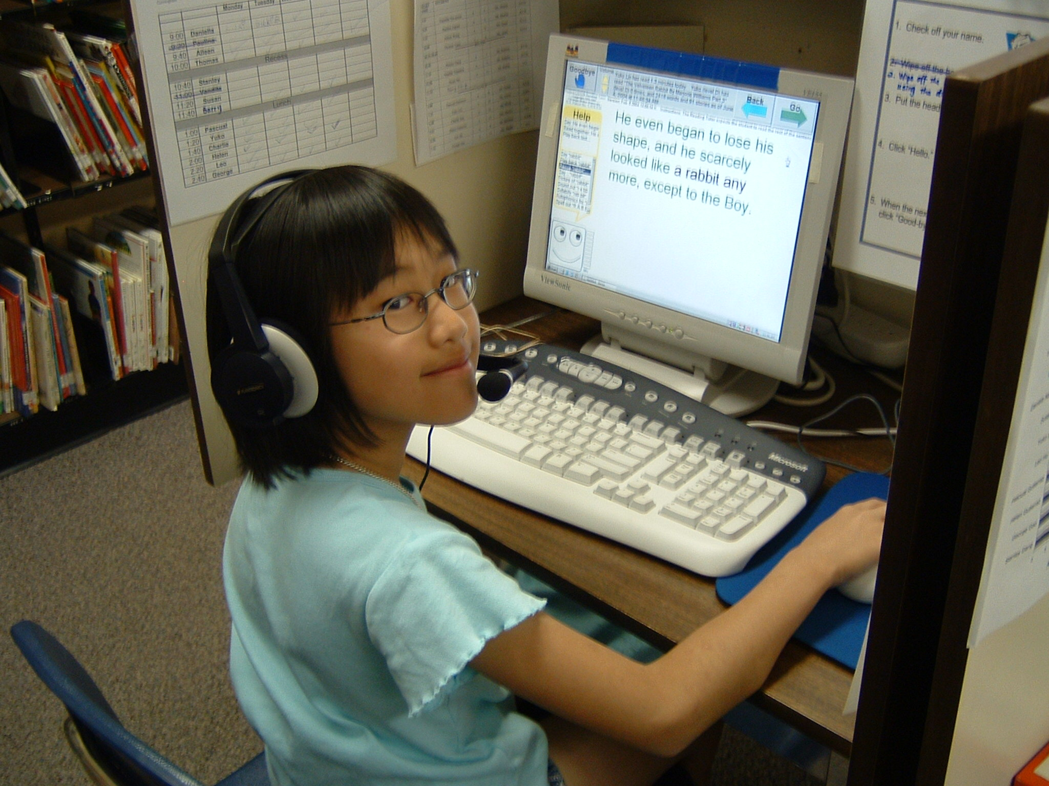
What is
The Reading Tutor?
The Reading Tutor
Computer based reading support for young EAL learners.
UBC and Carnegie-Mellon University
Notes:
KEN
Begin with brief overview of the Reading Tutor technology. The work came out of a collaboration between the RT’s developers at Project LISTEN, CMU,Pittsburgh USA and our team at UBC in Vancouver, Canada, who offered our colleagues at CMU the opportunity to study whether this tool, which was developed originally with native English speaking children in mind, could be successfully implemented with young English language learners, the new mainstream population in Cdn cities. So first: What is the RT?

Slide 5
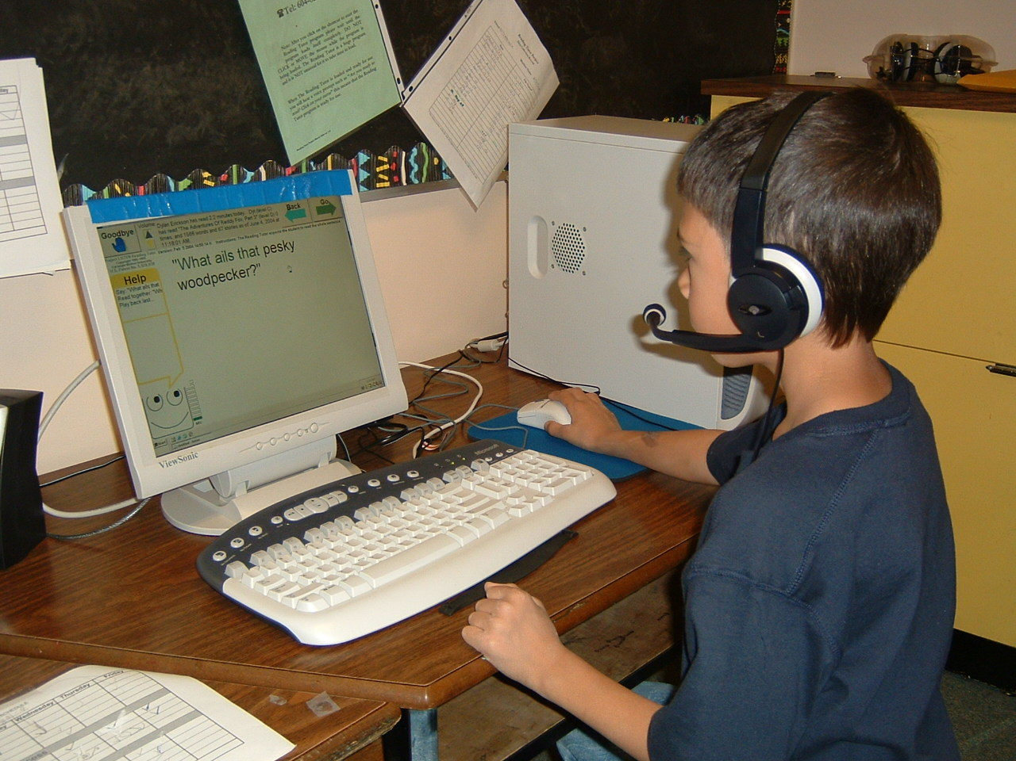
Developed by Project LISTEN, Carnegie Mellon University, The Reading Tutor is:
automated oral reading support that displays stories on a computer screen, and listens to children read aloud.
Notes:
KEN
Uses the Phoenix 2 speech processing engine, an advanced automated speech recognition system developed at CMU.

Slide 6
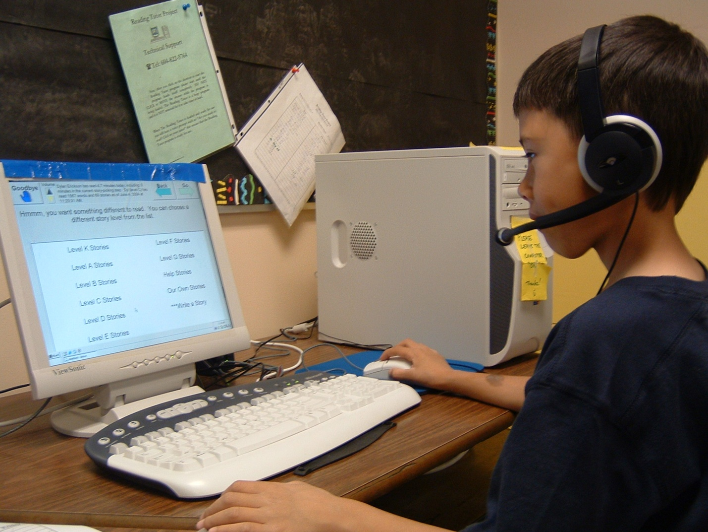
The Reading Tutor…
lets the child choose to read from a menu of high-interest stories.
Notes:
KEN
While we did not have the capacity in our recent trials to change the reading content in the RT, Reg D’Silva has recently done so and is currently running trials with college-age EAL students at UBC. We’ll report on that work later in our symposium as was noted.

Slide 7
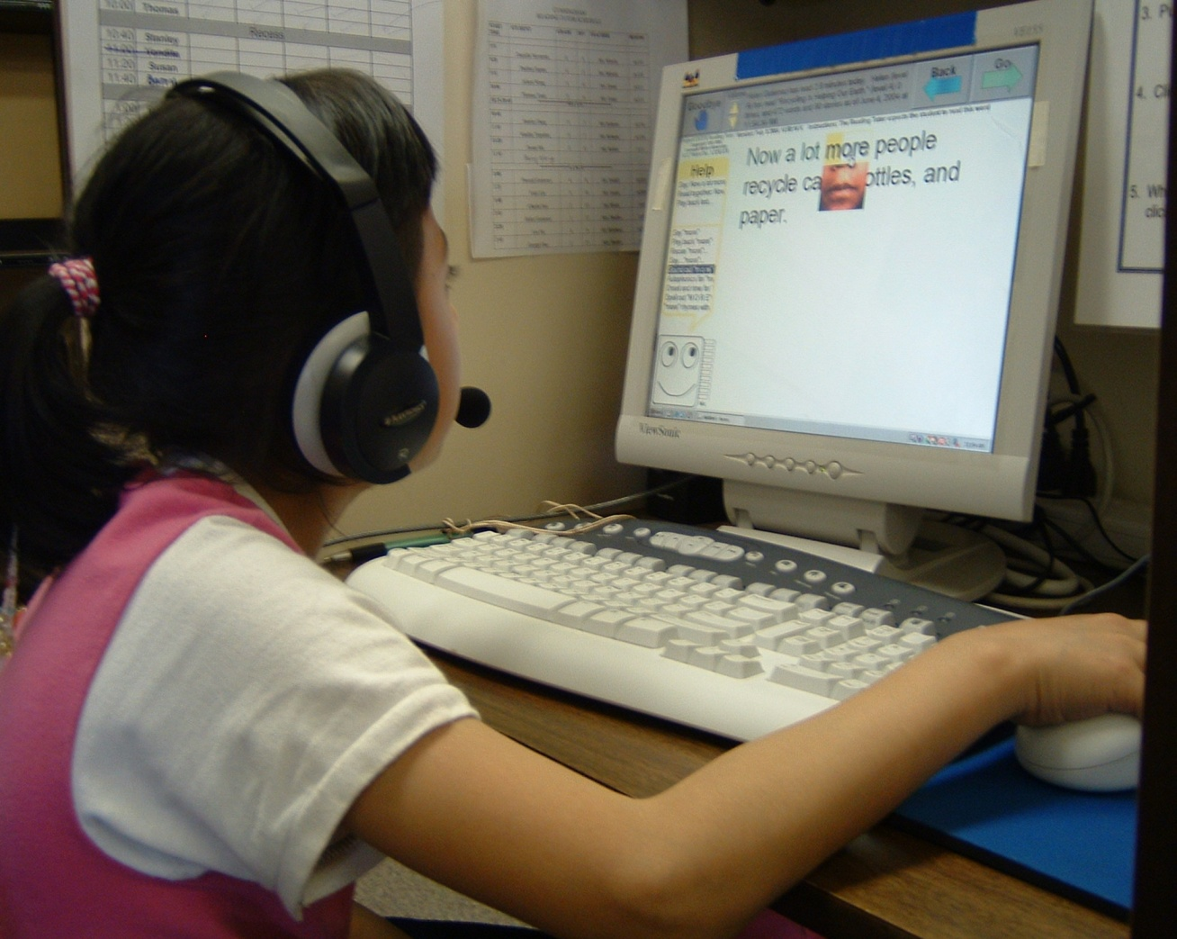

The Reading Tutor…
Automated speech recognition (ASR) analyzes the student's oral reading and offers help when the reader makes mistakes, gets stuck, clicks for help, or is likely to encounter difficulty.
CTV News video
Notes:
KEN
This is the essential “front end” of the system, designed by our project’s research collaborator Jack Mostow and his team at Project LISTEN, CMU, essentially an intelligent help system, highly context-driven, mainly triggered by lack of fluency in reading: e.g., long pauses, as well as major miscues/misreadings. Here’s a three-minute news spot that ran across Canada during our second year of work, by one of our national networks. (Publicity you can’t buy for any money!)

Slide 8
Does the feedback provided by the RT promote language development?
Language acquisition research tells us that “noticing errors” is crucial in language error correction and learning (Ellis, 2002; Iwabuchi & Fotos, 2004).
RT promotes noticing effectively because:
  Feedback provided by RT is subtle: failure to highlight incorrectly read text; signals that the program is waiting for improved reading only for major delays or errors.
  Feedback provided by RT is imperfect. Discourse flow is rarely interrupted, thus promoting fluency rather than 100% accuracy. (More natural, less robotic.)
  Because feedback from RT occurs in private, with no public failures or distractions, noticing is more effective.
Notes:
A note on the SLA theory we see as supporting the type of feedback that the RT provides to learners:
To the extent that reading development is underpinned by language development in general, then this is one reason that the RT can be an effective tool in promoting the development of reading proficiency for native speakers or second language learners alike.

Slide 9
UBC’s trials with L2 Learners:
Previous Findings (1)
Effectiveness of the RT when compared to human tutoring:
  Native English speaking children using the RT for 20 minutes/day made reading gains equal to those in a comparison group who received 30 minutes/day of tutoring in oral reading by trained volunteers.
  (Reeder et al 2005)
Notes:
KEN
Findings from Year One of our three year program of Canadian trials with English language learners, the new mainstream learners in our schools.

Slide 10
Previous Findings (2)
English language proficiency and reading gains:
  The low English proficiency group made greater gains on most measures than the higher proficiency groups and native speakers, outgaining the three other groups on Word Identification and Passage Comprehension measures.
      (Reeder et al, 2005)
Notes:
KEN
This finding is in line with most observations about pace of learning in novice groups compared to advance groups: steep early curve prior to plateau effects later.

Slide 11
Previous Findings (3)
Heritage language group (Mandarin, Hindi, Spanish*)
All three heritage language groups we studied made good gains in reading performance
Their gains compared favourably to those of children who spoke English as their native language.
(Reeder, et al, 2005)
Notes:
KEN: * Exception: Several native Spanish speakers who did not make comparable progress to children from other groups were mainly children in very recently-arrived refugee families whose educational history was either severely disrupted or in a few cases, non-existent., according to results of a followup queries of their schools.

Slide 12
Previous Findings (4)
Attitudes and concept of self and the RT experience: Results of two “paper & pencil” tests did not correlate with reading gains.
There were however very positive responses toward the RT experience demonstrated in a short post-RT interview. This held for all home language and English proficiency groups included in the study.
(Reeder, et al, 2005)
Notes:
KEN: From the second year of our program of trials.
JON: Paper and pencil measures may not adequately measure a psychology construct that probably develops over a longer period of time. The McKenna/Kear measure, while used widely, examines attitudes toward recreational and academic reading in a very cursory manner. Responses to the interviews indicated that the use of a computer, especially one that provided feedback in a non-threatening environment had potential for improving children’s views of reading.

Slide 13
Next step:
An effectiveness study, its goals
To compare gains in reading proficiency (fluency, comprehension) in EAL learners using the RT with EAL support with gains when taking classroom instruction with EAL support
to describe children’s attitudes toward reading, self-views as readers, and their experience while using the RT with EAL support.
Notes:
Two main goals for our final year of study, requiring multiple methods (quantitative/qualitative) employed in hybrid fashion within our third year of work. We turn now to a short report on our preliminary findings from our year of work, beginning with a look at the study’s population and setting, then an account of the reading proficiency gains. This is followed by a report of the affective findings.

Slide 14
II
Effectiveness study, goal one: reading proficiency gains with The Reading Tutor
Ken Reeder, Jon Shapiro and Jane Wakefield
Notes:
Ken as presenter of this section.

Slide 15
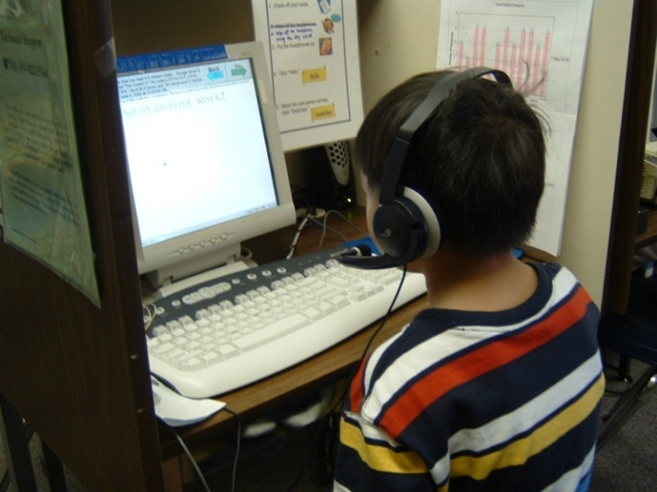
Participants
36 students from a Vancouver elementary school, grades 2-7, ages 6.8-12.6 years
ALL participants were receiving EAL (pullout) support and were provincially designated for funding
Gender: 14 female, 22 male
English proficiency range (Woodcock Muñoz): 17 – 33, beginners to low intermediates
Notes:
35 students available for some measures, since one child not available for final reading assessment.

Slide 16
Home languages were fairly representative of this city’s school population
Notes:
Distribution of these languages was very similar across the two treatment groups who will be described shortly. Majority of Cantonese and Vietnamese speakers would be born in Canada, generation 1.5, acquiring English at school.

Slide 17
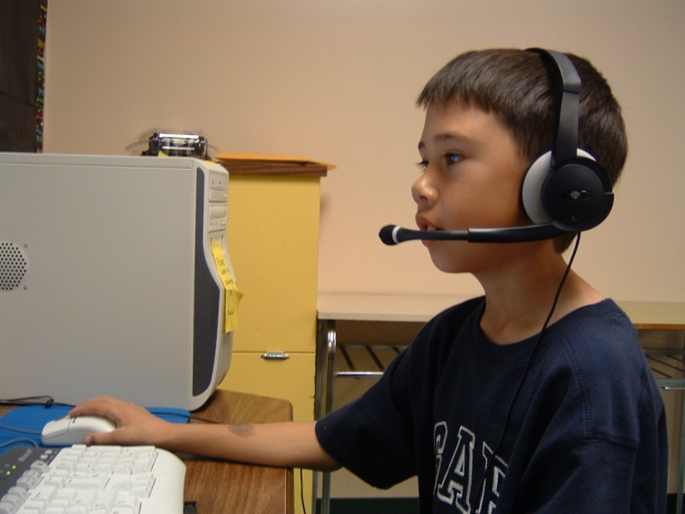
School Setting
Vancouver city schools: system has >50% non-English speaking households.
Lower income/SES neighborhood
Pullout ESL support as a transition to mainstream instruction in English.
Two Reading Tutor systems installed centrally in school library under Teacher Librarian’s supervision.
Notes:
KEN
Our study school was fairly typical of city schools in Vancouver, actually more than 90% of Ss in this school had a language other than English spoken at home, although many were born in Canada.

Slide 18
Research design
We used a mixed-methods approach:
Quantitative assessment of progress over time in reading fluency and reading comprehension
Qualitative assessment of changes over time in attitudes toward reading, sense of self as a reader, and views of the RT experience.
Notes:
We’ll also make an effort to link the overall design to our qualitative findings, in an effort to attribute some outcomes to the Reading Tutor. Use those findings to triangulate any quantitative outcomes we find, and perhaps to illuminate them as well.

Slide 19
Method: Crossover design
School assignment to groups G1, G2 to create quasi-experimental design, n=18 per group.
Crossover design, 3 testing and attitude interview periods, ❶ ❷ ❸
Reading Tutor: 20 minutes/day, 12 weeks
Phase I
October-Feb
Pretesting❶
G1: Reading Tutor
G2: Regular Instruction
Crossover
Mid-February
Midpoint testing❷
Phase 2
Feb-May
Post-testing ❸
G1: Regular Instruction
G2: Reading Tutor
G1 + G2 exchange conditions
Notes:
KEN:
the crossover design allowed us to look at the potential impact of the RT intervention twice, and has the advantage of adding some control over the simple impact of time, while not denying any participants an educational experience that has independently been shown to be promising and associated with gains in reading proficiency.
Note that testing occurs at the beginning and end of both treatment periods for both groups, in the two standardized measures (fluency, comprehension) but only before and after the RT treatment (not regular instruction) for those measures that were internal to the RT itself, i.e., fluency with RT materials, grade level of RT materials selected.)

Slide 20
Group composition: strong equivalence
 | GROUP 1 | GROUP 2
Age on entry | 8.7 yrs (6.8-11.4) | 8.6 yrs (7.0 – 12.6)
Gender | F=6 M=12 | F=8 M=10
English Proficiency | 26.7 (19-33) | 25.0 (17-30)
Initial Reading fluency | 60.3 words/min (16-108) | 51.7 words/min (9-120)
Initial Reading comprehension | 23.5 (6-40), Gates McGinitie | 23.2 (6-37), Gates McGinitie
Notes:
KEN
-In terms of similarity, groups came close to providing us with a matched sampling design for the study, but children were teacher-assigned, not randomly assigned to groups, since this was an ordinary school with fixed timetables and the usual constraints. Thus, a quasi-experimental design, not a true experiment. However this is offset by ecological validity of using intact school groups in more naturalistic groupings and normal timetabling.
-As just mentioned, groups were very similar in terms of home language also.

Slide 21
Reading Measures
[Gates-McGinitie Reading Test: Canadian standardized test of passage comprehension, normed with native speakers for grade level and time of year ❶ ❷ ❸ ]
Dibels Fluency Measure: wpm and wpmc on standardized test ❶ ❷ ❸
grade levels of Reading Tutor materials assigned by the RT’s internal selection routine (based on fluency) ❶ ❷ OR ❷ ❸
Internal Reading Tutor measure of reading fluency: words recognized by the RT’s speech analyzer per minute, averaged over one month ❶ ❷ OR ❷ ❸
Notes:
KEN
Note internal measure could be confounded by learning within speech analyzer: the system is constantly in training too, so could underestimate early state, hence exaggerate extent of users’ improvement over time.
Note also that this is a monthly average at beginning and end of the three month period, i.e. the first and the last month, thus not a fine grained or repeated measure.

Slide 22
PROCEDURE: Reading Gains
Objective was 20-25 minutes daily practice, 4 days per week on The Reading Tutor for ~4 months.
Actual values exceeded this objective:
    Group 1:
      52.0 days (min 40, max 61 days),
      19.9 hours (min 14.0, max 29.8 hrs)
    Group 2:
      51.3 days (min 32, max 64 days),
      19.3 hours (min 11.0, max 28.3 hours)
Notes:
KEN
Quite nice standardization of the RT treatment itself in terms of time on task, and distribution of practice time over the three month period.
The same could never be said, of course, of the regular classroom experience which would vary greatly according to grade and individual teacher. We now turn to our findings.

Slide 23
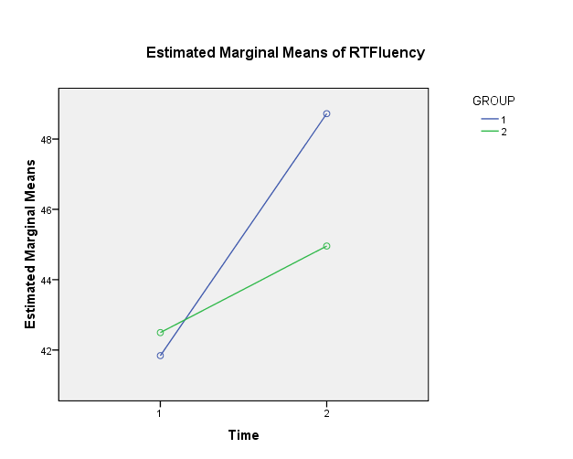
Internally measured fluency gains, start to finish of each RT treatment (4 mo)
Main effect of time (start, finish), F=4.92 (1,34), p=.03, effect size =.126.
A small order of treatment advantage/fall vs spring.
Effect size =.03
Notes:
KEN
This measure was taken only at the start and finish of each RT treatment, not for regular instruction condition. Main effect of time found, with no effects of group (i.e., treatment order) found.
Also note how fluency was defined within the RT logging system: sampled daily, adding to reliability of measurement but “words accepted” as caveat.
Overall, all students made strong gains in fluency regardless of treatment order.

Slide 24
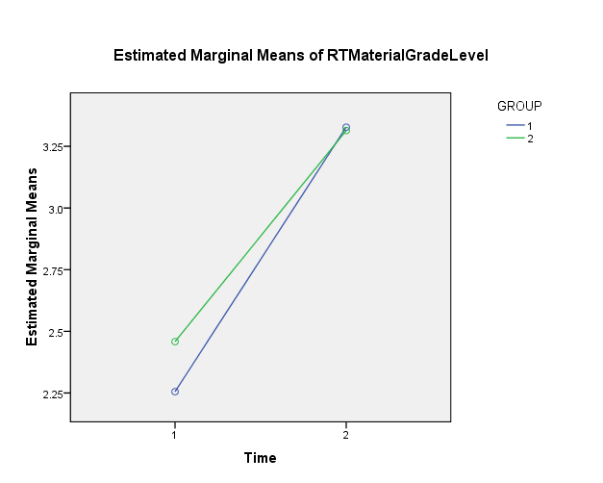
Grade level gains within RT materials, start, finish of each RT treatment (4 mo)
Main effect of Time , F=72.55 (1, 34), p=.000,
effect size .681. One year’s gain in four months.
No effects of Group were found, i.e., no treatment order advantage.
Notes:
KEN
Note that this is a somewhat arbitrary definition of grade level, assigned to RT’s reading materials, and the score is partly a function of the RT’s automated assignment of material, and partly a function of reader’s own selection of materials.
Ss’ Selection behaviour is presently being studied by Lei Hong at UBC: do readers accept the alternating assignment of materials by the RT, or go “out of level” when they can, and are those choices associated with reading gains? We report briefly on that ongoing analysis later in the symposium.

Slide 25
Working Hypothesis for comparisons of reading gains across treatment conditions
The Reading Tutor (RT) will be associated with greater gains in reading proficiency (fluency, comprehension) and positive gains in attitudes over time:
CLASSROOM ONLY
FINISH
CLASSROOM+ RT
crossover
CLASSROOM +RT
START
CLASSROOM ONLY
Notes:
Clearly we weren’t predicting that groups would begin or end at the same points, but only that the general trajectory of the developmental curves would follow the pattern illustrated here, with a relative advantage for the two RT treatment periods over the two classroom-only periods for each group.

Slide 26
Standardized fluency gains across the two conditions (Oct - Feb - June)
Notes:
KEN
Note “diamond” shape of two groups, in line with our predicted model of RT effectiveness.
However, only one between-condition effect showed a very small effect size, the one in the first term. (see green arrow).
The group effect suggests a slight advantage to beginning a school year with the RT. We return to that data point shortly.
We did not get results that were interpretable for our standardized comprehension test, because of measurement problems that compromised any comparisons.

Slide 27
Discussion: Gains in reading proficiency
The comparative contribution of The Reading Tutor to reading success appeared to have been very modest.¹
The treatment period, though longer and more intensive than some studies, was still relatively short in terms of what might be required to see robust gains in skills.
This comparison took place in the context of a highly effective school experience in which excellent ESL pullout support was provided to all learners.
  Note the strong effect size for time over the full year (.412).
  It could have been that a strong school experience throughout the year somewhat overshadowed or “masked” the contribution of The Reading Tutor.
Notes:
Fn 1: Note US study which we failed to replicate at least in effect size of RT treatment (Poulsen, 2004, eff. Size 1.14 for fluency gains over 4 weeks).
2. No quick fix for reading: driven by multiple factors, including affective dimension.
3. It was a very good year for all learners in the study.
4. Masking of RT effect by strong classroom instruction and outstanding, individualized and small group ESL support provided daily to all learners regardless of whether they were using the RT, even though a real effect.
5. One colleague in Aarau, Switzerland, previewed this result and noted that he was glad for once to see an intervention study that was not “stacked” instructionally to favour the intervention being studied, and we tentatively suggest that the US study of Poulsen may have done exactly that, with very poor participation rates on the RT, hence a selection effect in play as well as a very routine-sounding comparison condition that may have created a novelty effect out of the RT that was sustained over the short four weeks in that study.

Slide 28
III
Effectiveness study, part two: Reading attitudes, concept as readers, and students’ experience with The Reading Tutor
Jon Shapiro, Jane Wakefield and Ken Reeder
Notes:
Ken to introduce Jane, who will present on behalf of our colleague Jon who is taking part in his daughter’s wedding festivities in Vancouver, so sends his regrets and very best wishes to all.

Slide 29

Reading Attitudes, Self Concept and Students’ Experience
Three semi-structured clinical interviews: administered to participants pre-, mid- , and post conditions (1,2,3): 8 items.
Post RT interview: 6 items
    - Shapiro, et al., 2007
Selected items are reported here.
Notes:
JON
8 Items dealing with reading perceptions, attitudes and strategies
Students were seen individually and probed to expand on their responses
Questions:
Do you like to read in school? Why / why not?
Do you like to read at home? Why / why not?
How often do you read at home each week including weekends?
Is it easy for you to read new words?
Do you make a lot of mistakes when you read?
When you make a mistake in reading, what do you do about it?
How do you feel when you see a word you can’t figure out?
How do you feel when someone asks you to read aloud in front of a group?

Slide 30
“Do you like to read in school?”
(Grade 2 girl) G2
A little. I like to read picture books. Because it got some easy words for me to read.
A little. Because it's kind of fun to read but sometimes Mr. H. say "Read, put your books away" and I don't get to read the whole book.
Yes, a lot. Because it's fun to read because there's pictures and words so when we get to the end it's interesting.
Notes:
JANE
(TH, Grp 2, Vietnamese) improved over year – mid year (just starting RT) couldn’t finish book (frustrated); by end of year finishing book and enjoying content.

Slide 31
“Do you like to read in school?”
(Gr. 2 boy)
No, not at all. Because the words are sometimes hard.
Sometime. I just like looking at the pictures because I'm thinking things. I look at a picture and think what it's about and sometimes I read it.
A little. Because when I sometimes look at pictures I notice something interesting so I sometimes read the words.
Notes:
JANE
(EL, Group 1, Cantonese).
Gradual improvement: moving from dislike of reading to attending to pictures and then pictures and words.
Mid year, after RT) starting to add some strategies – looking at pictures for contextual information
Still no strategies for choosing books at appropriate level but is attending to words.

Slide 32
Student-level attitude change T1-T2-T3, for item 1: Do you like to read at school?
Theoretically predicted change
Notes:
Ken:
Group one received the RT during the first term, so might have been expected to show immediate gains in their attitudes toward reading (assuming that a successful experience in the RT at school generalized to more positive attitudes toward reading in school).
The majority of responses (8 out of the 18) showed no change in attitude from start to finish of the year. Some already liked reading – 3 of them alot; also comments show different reasons for answers – some related to reading; others around the circumstances of reading – availability of books, previous slide TH not enough time; reading is difficult
While only two children’s attitude improved following the RT experience, five also improved following their second term in which they had received only classroom instruction. Hence, there were a total of seven expressions of improved attitude over the course of the year, but only two of those positive changes took place immediately following the RT experience.
Group 2 by contrast had only regular class instruction in the T1 to T2 term, and worked on the RT in the term covered by T2 to T3. A surprisingly good number of these students showed a positive change in their attitude toward reading at school, ;6 out of 18, while only one of the 18 declined in their attitudes. A further three showed an increase in term one, with classroom instruction, for a total of 9 of the 18 children in this group showing positive change. 3 very positive at outset and remained so
Of the 9 children in group 2 who showed positive changes in their views of reading at school, twice as many (6) indicated that change in the period in which they received the RT compared to 3 in the period in which they did not receive the RT, only regular instruction.
Hence for Group 2, there is support for the view that the Reading Tutor was associated with positive changes in attitude toward reading at school.

Slide 33
“Do you like to read at home?”
(Gr. 2 boy)
Yes, if they're easy. Cuz there's not a lot of people making me feel sad like telling me I'm doing it wrong but at home no one tells me that.
Sometime. Sometimes I read books I got at school. Sometimes it might be funny. Sometimes it won't be funny. I just wanted to know if it's funny or not.
A little. Cuz sometimes the words are hard for me so I just read only a little bit.
Notes:
JANE
EL, Group 1
Same boy as in earlier slide. Self conscious about reading at school at the beginning of year.
Mid year. After a term with the RT, he is attending to genre, content.
End of year, and back to regular classroom instruction with ESL support: EL is back to a focus on decoding words, with less enjoyment ( attributable to his second-term classroom experience?)

Slide 34
Student-level attitude change T1-T2-T3 for item 2: Do you like to read at home?
Theoretically predicted change
Notes:
Ken:
Group 1: As noted previously, this group received the RT intervention in the T1-T2 term, and might have been expected to express positive change in attitude to reading at home, to the extent that a positive experience on the RT (as evidenced by items RT1-6) generalized to positive views about reading in general, including reading at home.
-Four of the 18 children in this group expressed positive change in their attitudes from T1 to T2, while 4 of them remained the same (whether they were positive, negative or indifferent). ’A little’ is not an indifferent response for children who are struggling with reading – very positive, somewhat, negative
8 of the 18 actually expressed a decline in their attitudes toward reading at home in this time period, a surprising result.
- A further 3 expressed positive change in the later period, T2 to T3 when they were receiving regular instruction only, for a total of 7 expressions of improved attitudes.
It is not possible to associate positive change in attitude toward reading at home with the experience of using the RT for this group. If anything there is a weak argument to be made for associating a declining attitude (for 8 children) with the period in which the RT was used. However, a further 4 children expressed a decline in attitude in the following term, T2-T3 indicating a broad decline in attitude regardless of term, and certainly not associated, immediately at least, with the use of the RT. Citing lack of time – homework, chores, lack of books,
However, it needs to be said that an equal number of children in this group (8), either showed an increase or held their own, remaining at the same level in their attitudes. Overall, 7 children in this group eventually changed their views in a positive direction over the year, bucking the slight trend toward decline in views toward home reading.
Group 2: This group, as noted, received the RT intervention in the second term, T2-T3. A good number, 6 of the 18, expressed an increasingly positive view of home reading, a further 3 stayed at the same level, while 6 members of this group expressed increasingly negative views of home reading during this interviewing period. (Many Ss cited) distractions – siblings, homework, lack of books, no English support (at home – kr).
Looking at the total of 9 students (3 in the first term, 6 in the second) whose attitudes moved in a positive direction over the year, clearly twice as much of that change occurred some time during the term in which the RT was being used.
A positive association between positive change and the use of the RT for this group must be tempered by the observation that, like in group 1, a large number (13) of children experienced a decline in their attitudes. However, because half of the decline occurred under the RT while another half occurred without the RT, it is impossible to associate the RT with a decline in attitudes toward reading at home. I.e., score one for the RT ;-) see above reasons (that were beyond the control of our study, or even the school to a great extent – sociocultural and community literacy elements. kr)

Slide 35
“When you make a mistake in reading, what do you do about it?”
(Grade 2 boy)
I just find another word - just look at the other page and see if something I know is there.
Sound it out. I try to figure it out from the picture. Look at the pictures -- give me ideas.
Sound it out. Try to figure it out from the story. Look at the word or look at the picture.
Notes:
JANE
EL, Group 1
Has basic strategies but starts to expand them over the year

Slide 36
When you make a mistake in reading, what do you do about it?”
(Grade 2 boy)
Ask my brother
Guess
Sound it out. Try to figure it out from the story.
Notes:
JANE
JL, Group 1, Cantonese.
Gradual expansion of strategies. Starting from asking for help to more independent strategies.

Slide 37
When you make a mistake in reading, what do you do about it?”
(Grade 4 girl)
Sound it out. Look at the words to see if there's some words that I know.
Ask someone. Try to see if any words in that word. Try to figure it out from the story.
Ask my parents but they don't know how to speak English. Sound it out. Try to see if any word I know in that word.
Notes:
JANE
T1 to T3
VZ, Cantonese, group 2.
From word recognition to analysis and context.

Slide 38
“How do you feel when you see a word you can’t figure out?”
(Grade 2 girl)
I feel confused.
Kinda grumpy.
I feel like the word might be difficult because I always try to pronounce it. In Grade 3 I still don't know the words. That's why I'm nervous.
(Grade 2 boy)
It makes me sometimes hungry. I don't really feel like anything. I just flip to the other page.
I don't feel anything I just go to the other page.
I feel like I can figure it out.
Notes:
JANE
T1 to T3r
TH, grp 1. Vietnamese. Girl anticipating difficulty in Grade 3
EL, group 1, Cantonese. Boy starting to attend to word structure.
(Jane, could you have some fun with the “hungry” response? When I present this to teachers, they find it quite creative and very evocative in an odd way. Just quick pointer to it, that’s all. - kr)

Slide 39
“How do you feel when someone asks you to read aloud in front of a group?”
(Grade 5 girl)
I feel okay.
I feel enthusiastic.
I like it only a little bit.
(Grade 4 girl)
I feel shy.
I feel shy
I feel shy because sometimes I don't know the word.
Notes:
JANE
Gr 5 girl = group 2 DT, Vietnamese
Gr 4 girl = group 2 IR, Cantonese
Generally not much confidence in public reading (cf RT private experience, as Janet’s comment confirmed)
*

Slide 40
When you make a mistake in reading, what do you do about it?”
(Grade 2 boy)
Ask my brother
Guess
Sound it out. Try to figure it out from the story.
Notes:
JANE
JL, Group 1, Cantonese.
Gradual expansion of strategies. Starting from asking for help to more independent strategies.

Slide 41
The Reading Tutor Experience Interview
Immediately following their final session using The Reading Tutor, children were asked about their experience using the program.
6 items, we report selected items only.
Notes:
JANE
General impressions of reading after RT experience and perceptions about strategies, fluency and comprehension
RT1. After using the RT, do you think you are getting better at reading?
RT2. After using the RT, do you read faster? When using the RT? In your other reading?
RT3. After using the RT, do you understand more of what you read better than before? When using the RT? In your other reading?
RT4. After using the RT, can you figure out words better than before? When using the RT? In your other reading?
RT5. Can you read more words now without sounding them out?
RT6. Thinking about your reading, what did the RT help you with the most?

Slide 42
RT1. After using the RT, do you think you are getting better at reading?
Yes. When you don't know a word you click on it and it tells you. That helps me.
Yes. Because when I read I know the words but before I don't know the words, now I know.
Yes. Because some words I don't know and now I know some words and I learned some new things in the RT.
No. Read the same stories. Because I keep reading the same stories. (RT) telling me to read other stories that are hard so I keep reading the same stories.
Notes:
JANE
Generally positive experience; gaining confidence in vocabulary building, word recognition
Sample responses

Slide 43
RT1. After using the RT, do you think you are getting better at reading?
Response |  |  |  |  | Freq.
Words, meanings, pronunciation and phonic strategies |  |  |  |  | 13
I can read and understand more |  |  |  |  | 10
I can read faster and more accurately |  |  |  |  | 4
Practice and pacing in RT helped me |  |  |  |  | 3
School report improved/RT moved me ahead |  |  |  |  | 3
I'm enjoying reading |  |  |  |  | 1
Writing improving |  |  |  |  | 1
No, I decided to stay at the same level in the RT |  |  |  |  | 1
TOTAL |  |  |  |  | 36
Notes:
Ken (Jane?)
* a large proportion of responses (13 of 36, 31%) mention word recognition or phonetic strategies.
* A large number of responses focused on reading more, and understanding more (10 of 36, 28%).
* While there were only 4 mentions of fluency and accuracy, there were 6 mentions of the benefits of the highly structured practice, pacing and progress tracking and promotion in the RT. Which might be a component of fluency
* Only one mention of enjoyment, and one mention of general literacy benefits. However, this Question asked about competence, not attitude.
* The single student who felt that there had been no benefit from the RT attributed this to his decision to reject the RT's selection of increasingly challenging reading levels. (Compare this data point to Lei’s preliminary findings re success and staying with RT’s suggested levels)

Slide 44
RT6. Thinking about your reading, what did the RT help you with the most?
They helped me to read because at home I try to read but I can't so then it helps me to read.
It helped me with the hard parts. It helped me with the reading -- just reading stories.
A little bit of reading -- understanding more
Teaching me dinosaur died a long time ago.
Reading more faster instead of stopping. Help me learn a bit new words -- sound it out.
Notes:
Appreciated support from RT so they could read ‘independently’ - not caught up in decoding, aided fluency, comprehension

Slide 45
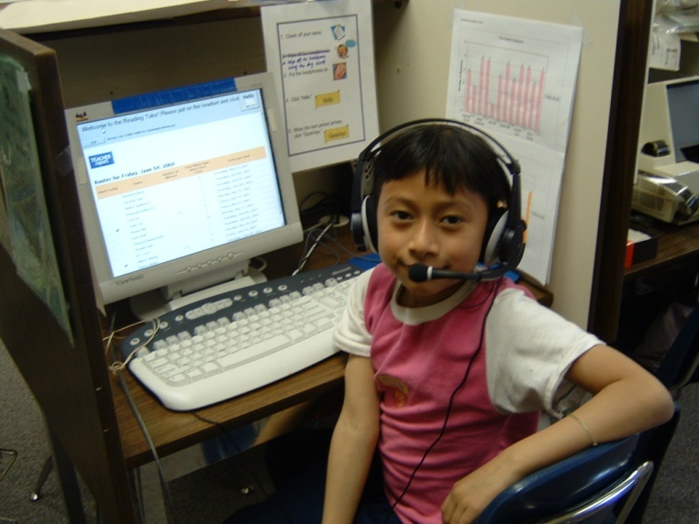
Cont’d
When I don't know I click the word and then it tells me ---learn more words.
When I don't read well they read it for me then I listen and I read it correctly.
Learn words that I don't know.
Notes:
JANE

Slide 46
RT6. Thinking about your reading, what did the RT help you with the most?
Response |  |  |  |  | Freq. | note
Learning new and harder words |  |  |  |  | 12 | comp
Being able to pronounce and sound out new words |  |  |  |  | 10
Practicing my reading, learning to get/use help |  |  |  |  | 5
Getting better at reading, reading stories |  |  |  |  | 4 | comp
Being able to read more now |  |  |  |  | 4 | fluency
Understanding what I read, and learning new things |  |  |  |  | 4 | comp
Being able to read faster now |  |  |  |  | 2 | fluency
Getting better at spelling or writing |  |  |  |  | 2
Getting better on the computer |  |  |  |  | 1
TOTAL |  |  |  |  | 44
Notes:
* 20 of the 44 responses (45%, including multiple responses from some children) referred to meaning or comprehension benefits ("comp" in note column of table) while only 6 responses mentioned (or implied) fluency benefits ("fluency" in note column.)
2 mentioned reading faster, 4 reading more.
* The category Learning new/hard words might be a combination of comprehension and word recognition so it could be concluded from this that the students recognized the help in the basic building blocks of reading literacy, i.e., recognizing words and understanding them and the text.
JW added: Practicing might also be fluency building.

Slide 47
Discussion: Interview data on reading attitudes, perceptions, and strategies
Generally, findings suggest:
Slight improvement in attitudes toward reading at school over the year: more detailed analysis is in progress on extent and direction of change over time.
Slight change in reports of using reading strategies.
Continued low confidence in reading publicly.
Attitudinal change takes an extended time, not 10-12 weeks. Longitudinal studies need to take this finding into account at their design stages.
Notes:
JON:
Attitudes toward reading take time to develop and, in fact, this time may actually be a few years as discovered in studies conducted in British Columbia back in the 1990s (Shapiro & White 1991, Reading attitudes and perceptions in traditional and non-traditional reading programs, Reading Research & Instruction, 30: 52-66; Shapiro (1990), Sex-role appropriateness of reading and reading instruction, Reading Psychology, 11:241-269.
The trend toward more positive views over the year might indicate that longer use (RT sessions only 10 weeks) and more success would further improve children’s attitudes.
The growth in strategy use was also a positive development and should be further tested with comparison groups.
And one should not be surprised by the fact that confidence in group oral reading did not grow, since this would need to be impacted by significant improvements in word recognition and fluency.

Slide 48
Discussion: Post RT Interview
RT support provided confidence to attempt new words and more difficult material.
Private not public performance was valued.
RT enabled readers to maintain a fluent pace.
Notes:
JON: The first result on this slide is probably attributed to the positive reinforcement provided by the RT in an environment free of anxiety, e.g. making mistakes in front of one’s peers and the teacher.
For struggling and beginning readers of English, the opportunity to practice privately was appreciated
Students really liked having the support of clicking on a word so that it didn’t interrupt their flow.

Slide 49
IV
Research in progress
Lei Hong & Reg D’Silva
The University of British Columbia
Notes:
We now turn to two studies currently progress, both being done by doctoral students in Language & Literacy Education at UBC. The first deals with learner choice of reading level in the RT, and the second, with adapting the RT for use by young adult learners.

Slide 50

ESL Children in an Intelligent CALL Program:
A study of learner choice in an electronic Reading Tutor
Lei Hong
The University of British Columbia

Slide 51
Research Questions
This study investigates how young L2 learners respond to RT’s choices of reading task levels and what paths they choose to follow in using the learner-adapted RT.
The study also intends to examine whether the learners’ choice of reading materials has any systematic relationships with learners’ attained L2 reading proficiency.

Slide 52
Research Method
Participants
  60 ESL students recruited from five different elementary schools in Vancouver, Canada
Procedure
  The participants work with The Reading Tutor on a daily basis during a period ranging from three to five months for 20 minutes per day.
  Each choice-making and reading activity is timed, recorded and logged in the databases of RT.
  A pretest and posttest of the students’ reading proficiency is conducted, using the WRMT-R.
Notes:
The basic data for this study was collected during the second year of our Vancouver study, in schools very similar to the one described earlier in our most recent year’s work.

Slide 53
Preliminary Findings
Over time most of the learners (over 80%) select the reading materials at the same difficulty level as the RT has assessed at, although different choices are given by the system.
Improvement on WRMT-R overall scores are made when the learners choose the RT’s recommended task level.
Correlations between how young L2 learners choice of reading task levels and their detailed reading proficiency attainment is undergoing full analysis at the moment.
Notes:
The WRMT-R was used in part because it is also used by our research collaborators in Project LISTEN at CMU. It provides not only details subtest scores (Word recognition, letter recognition, word comprehension, passage comprehension, but also an overall score which sums scores for all of the subtests.

Slide 54

Reading Skills , Young Adults and The Reading Tutor
Reg D’Silva
The University of British Columbia

Slide 55
Research Questions
What kinds of reading materials interest young adult EAL learners studying in a university academic exchange program?
How does the inclusion of student-preferred reading materials in a computer-based reading tool influence reading development of young adult EAL learners as measured by standardized tests?
Will the systematic use of a computer-based reading tool increase reading fluency in young adult EAL learners?
Will an increase in fluency be associated with increases in reading comprehension scores as measured by standardized tests?

Slide 56
Research Design
Two Phase Approach
Phase I – Survey to determine reading interests and to form two experimental and one control group
Phase II – Intervention with Reading Tutor after incorporating suitable reading materials
Notes:
Note Reg’s engineering background and technical training with the Project LISTEN team at CMU a year ago, in order to alter the RT’s reading content to suit this age and interest group.
56

Slide 57
Research Design
GRP1 – Like reading current event materials
GRP2 – Don’t like reading current event materials
GRP3 – Control-- remaining students after forming GRP1 &2
Survey
Pre test – Fluency & Comprehension
Modified RT Content
RT
Intervention
Post test – Fluency & Comprehension
Exit Interviews
Notes:
REG This is a two phase design and the input from the survey helps in building the groups for the RT intervention phase.
- With this modular design the survey responses aid in answering the research question about reading interests of the participants while helping in deciding two groups-- as in this case students who did like reading world current events and those that did not.
- Exit interviews add an anecdotal dimension to the quantitative analysis.
57

Slide 58
Pilot Study
November ’08 to April ’09 at a UBC international student exchange program
27 survey participants ( Japanese students)
Nine participants signed up for RT intervention over four weeks
Six completed both pre and post testing and exit interviews
Reading materials incorporated were based on world current events
Nelson Denny test for reading comprehension
Curriculum Based Measurement, one minute reading for fluency
Notes:
Reg: Note the small number of students that formed part of this study, which is why it was made a pilot.
- However, the design was carried out as planned so it served as a good learning exercise.
58

Slide 59
Reading Performance
Notes:
Reg: Only a marginal gain in fluency was observed over the four weeks of the intervention.

Slide 60
Reading Performance
Notes:
Reg: Some post comprehension scores were lower than pre-scores after 4 weeks.

Slide 61
Overall Performance (N=6)
Notes:
Reg: This is an average of pre and post fluency and comprehension scores
it appears that overall there was a marginal loss in comprehension while there was marginal gain in fluency.
- These results are difficult to interpret given the short term (RT intervention was for approx. 4 weeks) and small number of students.
Also no comparisons could be made given so few data points.

Slide 62
Exit Interview Comments:
Was your experience with RT helpful?
Reading loudly makes a difference, so I think it is really important.
I think it is a good material to improve pronunciation.
The software is helpful for me because after reading the sentence I could hear the voice. I hear before and after...I check the pronunciation.
I think it is useful but I don’t think it is the most useful way for reading but it helps building confidence for communication in English in general.
I think it will improve reading not communication.
Notes:
The interview material provided a good way of triangulating the quantitative reading gain scores, and allowed the users’ voices to be heard, as in the earlier studies’ interviews.
62

Slide 63

Looking Ahead
Continue the study starting September 2009 with Japanese exchange students arriving at UBC for Fall’09 term.
Use longer term intervention in next phase.
Notes:
63

Slide 64




Thank You – Reginald D’Silva
School
Church
Notes:
Reg offered, at my invitation, a pictorial account of his Indian heritage in a city in India, Mangalore, which has a rich Portuguese heritage remaining from its colonial era. It also explains how an Indo-Canadian graduate student who was born in India bears a well known Portuguese name!
64

Slide 65
V
Discussant’s Remarks
Dieter Isler
Pädagogische Hochschüle Zürich
Notes:
We now welcome our friend and colleague Dieter Isler from PHZH who will offer some observations on the research that we have presented this morning.

Slide 66
Your questions?
Please ask here,
or email ken.reeder@ubc.ca.
Learn more about Project LISTEN at its web site:
http://www-2.cs.cmu.edu/~listen/
Notes:
Ken, Jane, Dieter to respond to open questions and discussion for remainder of allotted time.

Slide 67
Muito obrigata/o
Thank you!
Danke schön!

