Slide 1
Detecting Prosody Improvement in Oral Rereading
Minh Duong and Jack Mostow
Project LISTEN
www.cs.cmu.edu/~listen
Carnegie Mellon University
The research reported here was supported by the Institute of Education Sciences, U.S. Department of Education, through Grants R305A080628. The opinions expressed are those of the authors and do not necessarily represent the views of the Institute or the U.S. Department of Education.

Slide 2
Motivation
A tutor should be able to detect improvement in:
Oral reading rate
And prosody (rhythm, intensity, intonation, pauses)
When?
In reading new texts [our AIED2009 paper]
In rereading same text [this SLaTE 2009 paper]
Faster improvement than on new text
Easier to detect because controlling for text reduces variance
Popular, effective form of practice
This work: detect prosody improvement in rereading.
Notes:
(Not sure what to annotate here)
Rereading eliminates variance due to differences in text

Slide 3
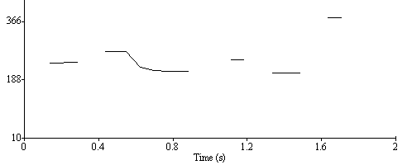
A real example
Text: “Don’t you like surprises?”
A second grader’s 1st reading
Her 2nd reading, 5 days later
Adult narration
Notes:
[Click on each icon to hear the recording and see its prosodic contour get abstracted to the word level]
As you can see, the second reading resembled the adult narration a lot more than the first one.
(Child was at grade level according to paper tests. She also didn’t hear the adult narration before reading the text.)

Slide 4
Prosodic attributes
Duration: how long
Latency
Production
Normalized
Mean intensity: how loud
Mean pitch: how high
Time
Notes:
In order to quantify prosody, we looked at various aspects of students’ readings, such as duration, latency, production, pitch and intensity. For the temporal attributes (duration, latency and production), we also computed their per-letter normalized versions, because we found that duration had a strong linear correlation with word length, as shown in the graph.

Slide 5
Raw features
Raw duration, latency, and production
Absolute and normalized by word length
Averaged within sentence
Pause frequency
Percent of words with latency > 10 ms (or rejected)
Pitch variation
Standard deviation of word pitch within sentence
Notes:
From those basic attributes of prosody, we computed the following raw features for each sentence reading…

Slide 6
Correlational features
Expressive reading reflects comprehension
Expressive readers’ prosody resembles adults’
[Schwanenflugel et al. ’04, ’06, ’08; Mostow & Duong AIED ’09]
Correlate child and adult prosodic contours
For each prosodic attribute (latency, pitch, intensity, …)
Represented as its sequence of values
For the words in the same sentence
E.g. pitch correlation increases from 0.37 to 0.90
Notes:
In addition, previous studies by Schwanenflugel and colleagues, as well as our own, found that …
Motivated by these findings, for each prosodic attribute, we computed a correlational feature for each sentence as the Pearson Correlation Coefficient between the child and adult’s sequence of word-level values.

Slide 7
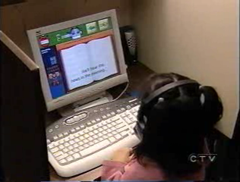
Data source: Project LISTEN’s Reading Tutor
See Videos page at www.cs.cmu.edu/~listen
Notes:
Reading Tutor that listens to children read aloud and responds with spoken and graphical feedback, as well as child’s help requests.

Slide 8
Data set: 29,794 sentence rereadings
164 students in grades 2-4
Used the Reading Tutor at school in 2005-2006
Read 77,693 sentences; 38% were rereadings
Students averaged 132 rereadings (1-1891) and reread those sentences 1.66 times on average
Notes:
4901 distinct sentences
77,693 sentence readings, of which 38% were rereadings

Slide 9
Analyses
Which features were most sensitive to gains?
Can we detect learning?
Which features detected individual gains?
Notes:
In our analyses, we sought to answer these 3 research questions:

Slide 10
1. How to measure feature sensitivity?
As median per-student effect size for a sentence-level feature (e.g. correlation with adult pitch)
Sentence:
Gain:
Student:
Feature:
1st reading
0.37
+0.53
2nd reading
0.90
Mary
{+0.53, -0.05, …}
Correl pitch
…..
→ Effect size = mean/SD
= 0.08
-0.05
…..
{0.08, 0.12, …} →
Median effect size = 0.10
Joe
…….
Effect size = 0.12
Notes:
We quantified feature sensitivity as the median per student effect size.
In particular, starting at the sentence level…
[Note in case someone asks: ES is an aggregate property; z-scores are not.]

Slide 11
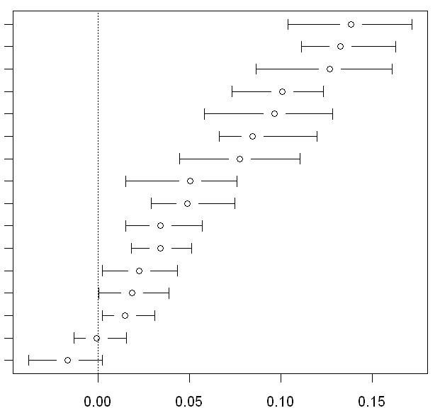
1. Which features were most sensitive?...
raw duration
raw norm duration
raw norm production
pause frequency
raw production
raw norm latency
raw latency
correl duration
correl production
correl latency
correl norm latency
correl norm duration
pitch variation
correl norm production
correl pitch
correl intensity
Median effect size
Median effect size ± 95 % confidence interval
Notes:
To find the most sensitive features, we applied the previously described method to our dataset…

Slide 12
1. Temporal features most sensitive
raw duration*
raw norm duration *
raw norm production *
pause frequency *
raw production *
raw norm latency *
raw latency *
correl duration *
correl production *
correl latency *
correl norm latency *
correl norm duration*
pitch variation*
correl norm production*
correl pitch
correl intensity
Median effect size
*: significantly > 0
at 0.05 level
Median effect size ± 95 % confidence interval
Notes:
… and found that temporal features (in red), especially the raw ones, were most sensitive, as measured by median effect size of mean student gain.
(Why? Correlational features depend not only on the student’s speech but also on the particular adult’s → additional variability and measurement noise, → useful for assessing the quality of students’ prosody, but raw features are more sensitive to its improvement.)
(95% confidence interval: we computed confidence intervals around the median effect sizes using the bootstrapping method, assuming normality among the medians of 100 sets (sampled with replacement))

Slide 13
2. Can we detect learning?
Do gains indicate learning, or just recency effects?
We split rereadings into:
The same day: could be short-term recency effect
A later day: actual “learning”
Then computed effect sizes as before.
Notes:
(Explain: not necessarily generalizing to new contexts (learning); might just be memorizing, but at least retaining overnight)

Slide 14
2. Which features detected learning?...
raw duration
raw norm duration
raw norm production
pause frequency
raw production
raw norm latency
raw latency
correl duration
correl production
correl latency
correl norm latency
correl norm duration
pitch variation
correl norm production
correl pitch
correl intensity
Notes:
(Notes on next slide)

Slide 15
2. Temporal features detected learning
raw duration*
raw norm duration*
raw norm production*
pause frequency*
raw production*
raw norm latency*
raw latency*
correl duration*
correl production*
correl latency
correl norm latency*
correl norm duration*
pitch variation
correl norm production
correl pitch
correl intensity
*: significantly > 0
at 0.05 level
15
Notes:
(one-tailed t-test that learning > 0)
In this graph, we sorted the features in the same order in which they appeared in the first graph (showing feature sensitivity overall).
Again, we found that temporal features were more sensitive to later day improvement/ learning.

Slide 16
2. How did learning compare with recency effects?
raw duration
raw norm duration
raw norm production
pause frequency
raw production
raw norm latency
raw latency
correl duration
correl production
correl latency
correl norm latency
correl norm duration
pitch variation
correl norm production
correl pitch
correl intensity

Slide 17
2. Recency ~ 2x learning where differed significantly
raw duration*
raw norm duration*
raw norm production*
pause frequency*
raw production*
raw norm latency
raw latency
correl duration
correl production
correl latency
correl norm latency
correl norm duration
pitch variation
correl norm production
correl pitch
correl intensity
*: Recency > Learning at 0.05 level
17
Notes:
(one-tailed, paired t-test for each feature, pairing each student’s effect sizes for two cases)
Recency effects were almost twice as large as learning effects for the features where recency was significantly greater than learning.

Slide 18
3. Which features detected individual gains?
What % of students gained significantly (on a 1-tailed paired T-test) from one reading to the next:
Overall
When rereading on the same day (“recency effect”)
When rereading on a later day (“learning”)
Notes:
The statistical significance tests described above are for overall differences between features or same- vs. later-day. What about for individuals? Are any features sensitive enough to detect improvements that are statistically reliable for particular students? To answer, we carried out a one-tailed paired T-test for each student’s set of feature values, repeated for each feature.

Slide 19
3. Which features detected individual gains? Overall
raw duration
raw norm duration
raw norm production
pause frequency
raw production
raw norm latency
raw latency
correl duration
correl production
correl latency
correl norm latency
correl norm duration
pitch variation
correl norm production
correl pitch
correl intensity
Notes:
Features that had greater effect sizes, also tend to have higher % of students with significant improvement.

Slide 20
3. Which features detected individual gains? Same day vs. later day
raw duration
raw norm duration
raw norm production
pause frequency
raw production
raw norm latency
raw latency
correl duration
correl production
correl latency
correl norm latency
correl norm duration
pitch variation
correl norm production
correl pitch
correl intensity
Notes:
Later day results didn’t lag behind same day as much as when computing median effect sizes.
Raw norm duration is best for later day/learning.

Slide 21
3. How does individual gains’ significance depend on amount of data?
Raw normalized duration (most sensitive overall)
Notes:
To analyze the effect of having a large amount of data on the significance of individual gains, we ranked the students by their amount of data, split them into 10 bins of equal size, then computed the % of students w/ significant gains for each bin.
(Note: fluent students might not read as much → smaller amount of data)

Slide 22
Conclusions
Which features were most sensitive to gains?
Temporal, especially raw
Did we detect learning, not just recency effects?
Yes, but recency was ~2x stronger where different
Did we reliably detect individual gains?
Yes, for ~40% of all students
No, for students who reread fewer than 21 sentences
Yes, for 60% of students who reread 336+ sentences
Notes:
(Not sure what to annotate here)

Slide 23
Limitations and future work
Why didn’t pitch or intensity features detect gains?
Less sensitive to growth, e.g. than word decoding?
Measurement error, e.g. in pitch tracking?
Within-student variance, e.g. mic position or noise?
Across-sentence variance, e.g. adult narration?
Extend to work without adult narrations?
Extend to detect gains in reading new text?
Notes:
(Not sure what to annotate here)

Slide 24
Thank you! Questions?

Slide 25
Long words are slower.
Notes:
Averaged over hundreds of thousands of words recognized by the Reading Tutor

